Slide 1
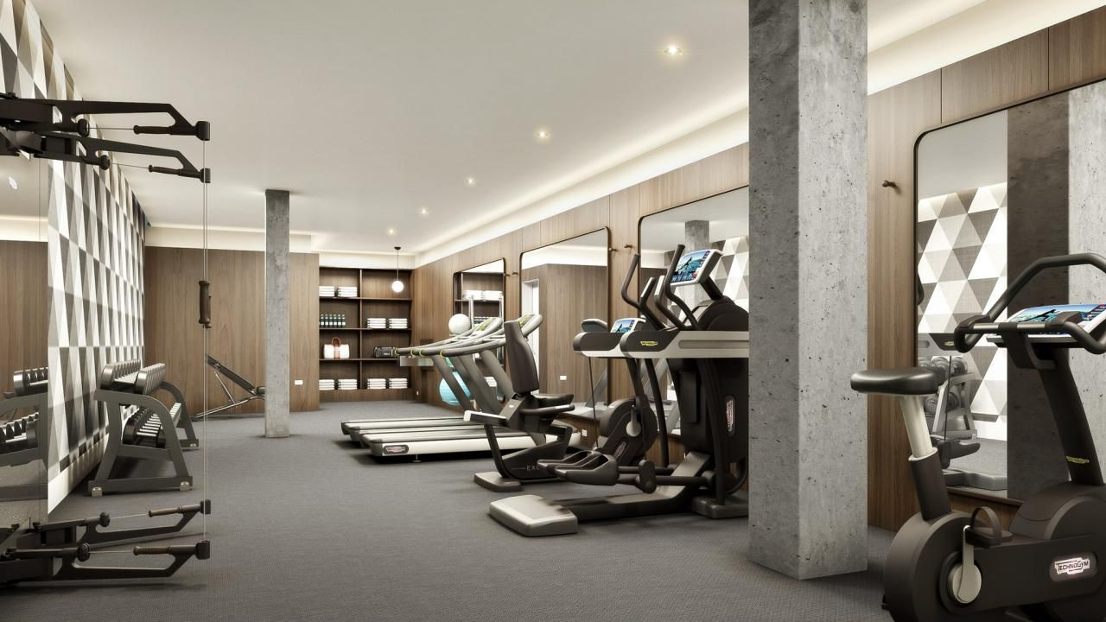

Team 14: Nikul, Aanya, William
Unifit
Notes:
Introduction: William

Slide 2

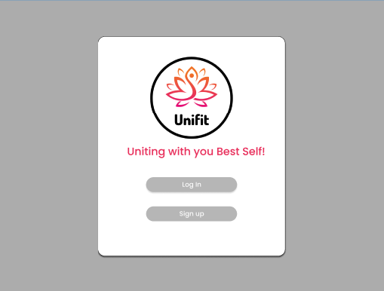
What is Unifit?
Creates weekly fitness plans:
Individuals stats
Personal Information
Goals
Videos
Membership-free fitness website
LET’S GET STARTED
Notes:
Will

Slide 3




Who Does Unifit Serve?
For all age groups
Individuals new to working out
Easy access to workouts and custom weekly plan
Notes:
Aanya
From teenagers to adults
Unifit is for individuals looking to live a healthier physical lifestyle
Because Unifit provides easy access to a weekly plan

Slide 4
Person A: Jake
College Student
New to working out
Did not take Weight Training in high school
Has a new goal of building muscle
Does not know where to start
He can use Unifit as a tool to achieve his goals
Notes:
Aanya

Slide 5
Person B: Billy
Adult in their 30’s
They started gaining weight after working double shifts and having Taco Bell for dinner everyday
Wants to start losing weight and lower body fat percentage to maintain a healthier lifestyle
He can use Unifit as a tool to achieve his goals
Notes:
Aanya

Slide 6
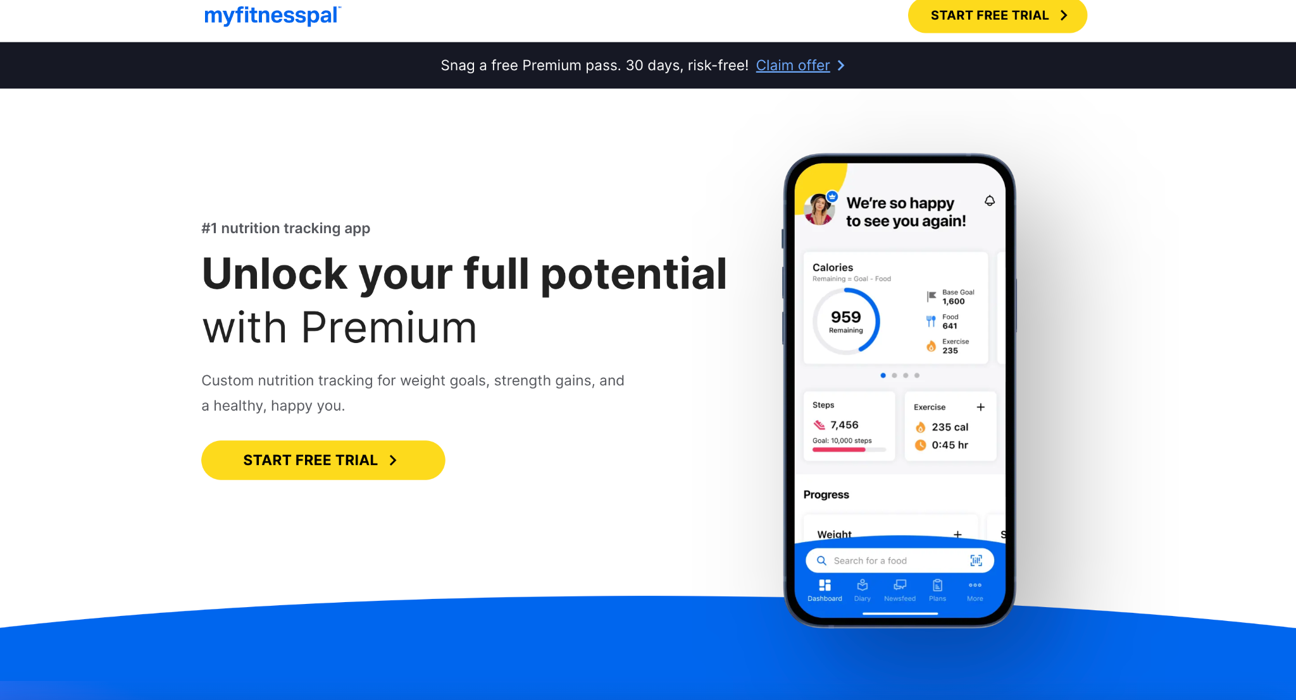
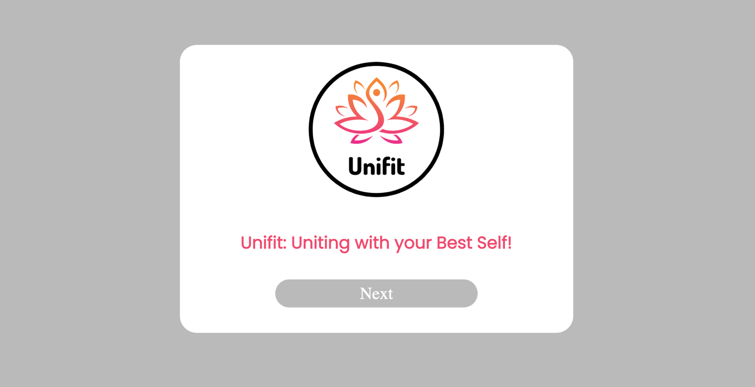
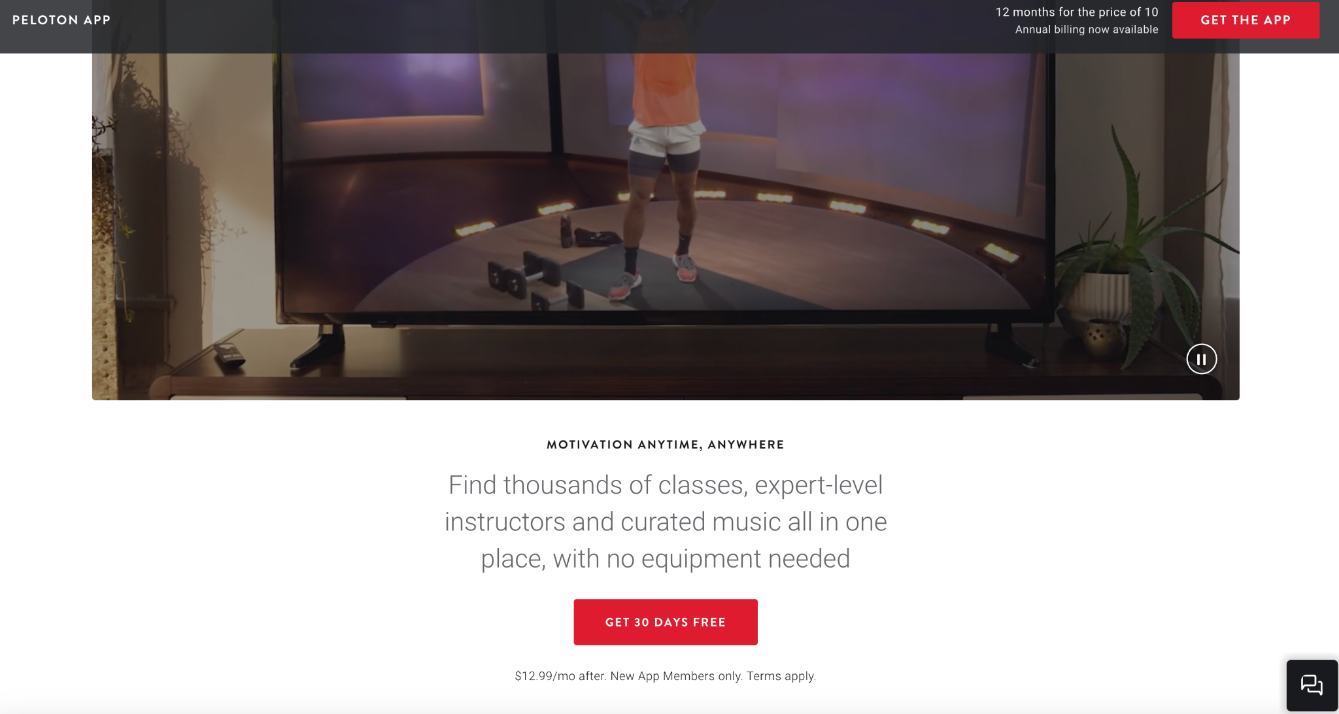
Comparison and Demand
Notes:
William

Slide 7
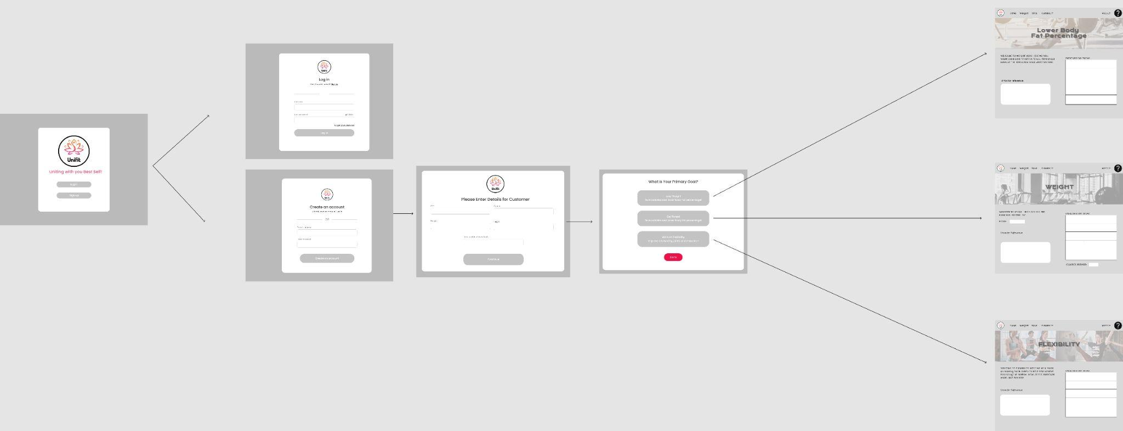
Initial Design
Notes:
Will

Slide 8
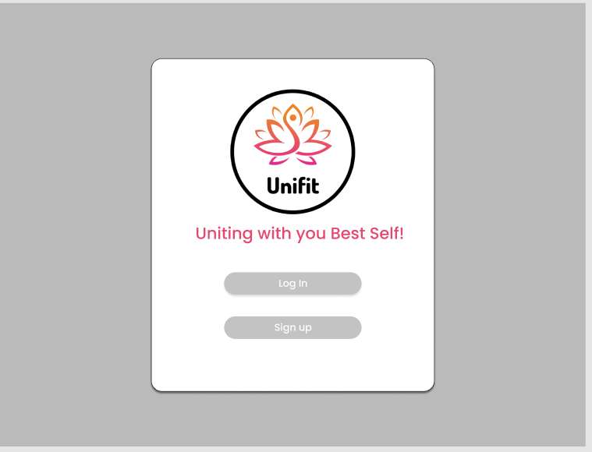
Initial Design
Notes:
Will

Slide 9
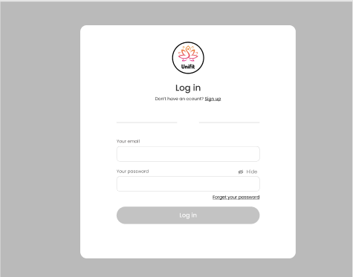
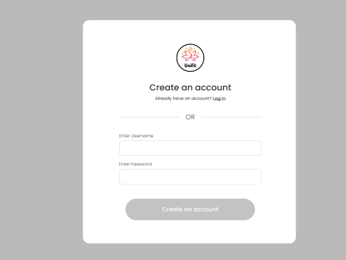
Initial Design
Notes:
Will

Slide 10
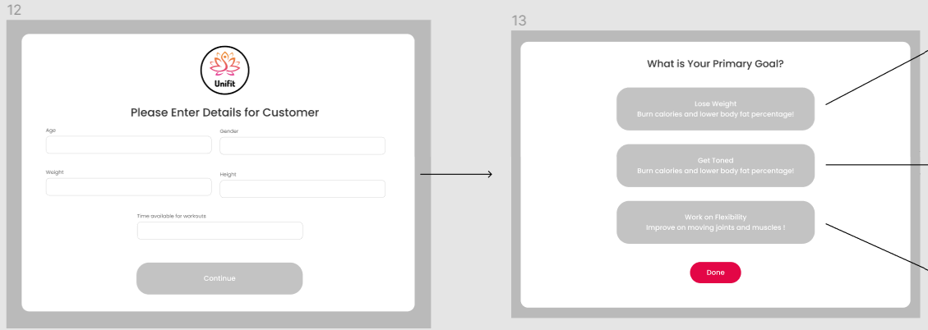
Initial Design
Notes:
Will

Slide 11
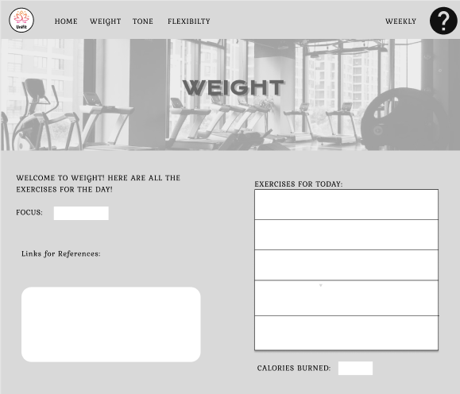
Initial Design
Notes:
Will

Slide 12
How Unifit Works
User will be asked to create an account
Body details such as Height, Weight, Age and Gender
Enter you fitness goal
All the body details of the user will be display such as their BMI, BMR and so on
User will get to a weekly plan based on their fitness goal
Users can access their weekly plan anytime!
Let’s see a live demo of our application:
http://pateln14rpi.eastus.cloudapp.azure.com/team/homepage.html
Notes:
demo slides 3 - 4 minutes (Nikul) (Weekly Plan - Aanya)

Slide 13
The Process
OUR TIMELINE AND DIVISIONS
STEP 1
STEP 2
STEP 3
STEP 4
STEP 5
Create html pages matching initial design
Include functions like validating and directing pages
Make the user login work using a database
Import a database of exercises or create one
Display a custom weekly plan using the table of exercises
Notes:
Aanya

Slide 14
Challenges
HTML TO PHP
Converting our HTML templates as shown in our initial design to PHP files and using phpMyAdmin for the structure
TESTING USER LOGIN(PHP)
Making changes to PHP, committing, pushing, and testing across multiple devices as we collaborated
Our main challenges and how we dealt with them throughout the process of developing our application.
Notes:
Aanya

Slide 15
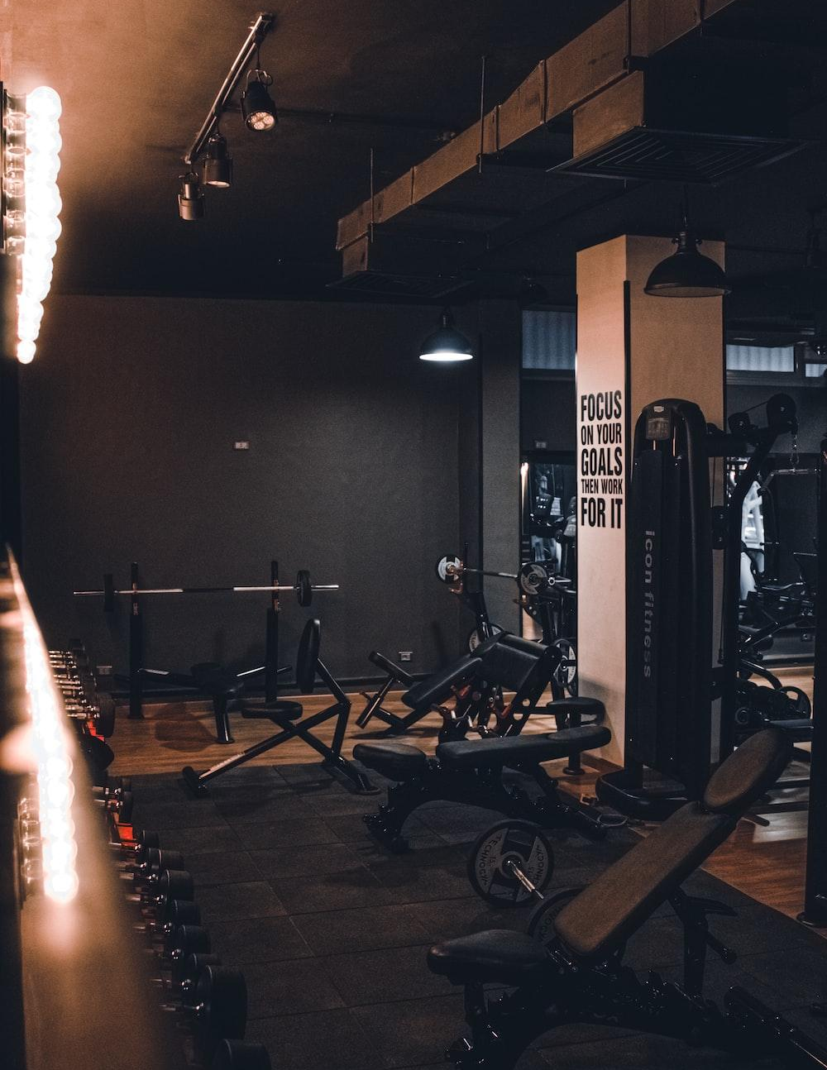
Moving Forward
Login or Create Account
Enter details
Generate Weekly Plan
Recap
Information Architecture
HTML vs PHP
Sorted by feature
College Community
Adding variety to workout plan
Customization within the plan based on preferences
Features
Conclusion
Main elements
Overall Potential
Notes:
Aanya

Slide 16

thank you!
Notes:
Aanya

